Slide 1

Maths Reception
Stalbridge Primary School
Information for parents 2023

Slide 2
Aims
  What does the EYFS curriculum look like?
  What does maths in school look like?
  Useful resources – Physical, books and websites
  How you can help at home

Slide 3
EYFS Maths Curriculum
There are two Early Learning Goals for maths which most children are expected to achieve by the end of reception.
Number:
Have a deep understanding of number to 10, including the composition of each number.
Subitise (recognise quantities without counting) up to 5;
Automatically recall (without reference to rhymes, counting or other aids) number bonds up to 5 (including subtraction facts) and some number bonds to 10, including double facts.
Numerical Patterns:
- Verbally count beyond 20, recognising the pattern of the counting system;
Compare quantities up to 10 in different contexts, recognising when one quantity is greater than, less than or the same as the other quantity;
Explore and represent patterns within numbers up to 10, including evens and odds, double facts and how quantities can be distributed equally

Slide 4
Developing a strong grounding in number is essential so that all children develop the necessary building blocks to excel mathematically . It is important that children develop positive attitudes and interests in mathematics, look for patterns and relationships, spot connections, ‘have a go’, talk to adults and peers about what they notice and not be afraid to make mistakes.
Please start by watching this video. It talks about the importance of understanding mathematics taught in EYFS and the different ways that mathematical understanding is developed in Reception and why.
https://www.youtube.com/watch?v=2Ow8vEmh8lA
When counting, children need to understand these key principles …
The one-one principle. One number name is assigned to each object that is being counted.
The stable-order principle. When counting, numbers have to be said in a certain order.
The cardinal principle The number name assigned to the final object in a group is the number of objects in that group.
The abstraction principle. Anything can be counted including things that cannot be touched eg sounds and movements.
The order-irrelevance principle. The order we count objects is irrelevant.
Subitising: Recognising amounts without counting.
Perceptual subitising: Recognise a whole amount without counting eg 3 fingers, 2 on a dice, a 4 piece of numicon.
Conceptual subitising: Recognising amounts in sub groups (without counting) and combining to make a whole e.g. 5 dots can be seen as a 3 and a 2.

Slide 5
What does maths look like in school?
White Rose scheme of learning:
“Adopting a White Rose Maths approach to teaching means making sure all children have the same opportunities to learn and the support they need to fully grasp concepts.” White Rose
We use a CPA approach (Concrete, Pictorial, Abstract). Children need to use tangible objects first (concrete), followed by pictorial representations and finally abstract eg 6+3=
We teaching for fluency, reasoning and problem solving.
We use complimentary resources such as books and songs to engage our children.

Slide 6
How you can help at home.
Counting – in everyday conversation, in play, steps, brushing teeth, toys in the bath, tidying toys.
Subitising – with teddies, spoons, socks
Ordering numbers – flashcards, post it notes, lining up toys. Add in some reasoning, perhaps one number from the numberline is missing or in the wrong order.
Spot numbers in the environment – on phones, microwaves, clocks, registration plates, doors.
Ask children to set the table with enough knives, forks and plates for everyone – include it in everyday conversation, cooking.
Deliberately make mistakes. Children need to understand mistakes are normal and everyone makes them e.g. get mixed up when counting, muddle two numbers when ordering them.
Play games with dice or dominos and encourage child to say how many spots without counting.
Snakes and ladders, card games – uno, snap, pairs.
Hide and seek (counting to 10)
Bingo
Counting songs
Play outdoor maths games like hopscotch and skittles. Even better, let children make up their own games and decide how to score points.
Hide numbers around the house or garden for children to find.
Make repeating patterns – ordering objects and toys, clapping/body percussion
2D shapes – in everyday conversation, shape hunts, shape pictures
Number formation
Model number writing and reading in different ways: Lists, tracing, birthday cards, buses, front doors, recipes, in books, phones
Write in sand, with your finger on the carpet, paint, make numbers with play dough, on a whiteboard, on paper, post it notes, on a tablet

Slide 7
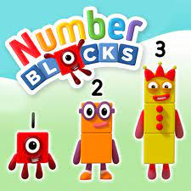

Useful Resources
https://apps.apple.com/gb/app/maths-shed/id1448290813
Numberblocks https://www.bbc.co.uk/cbeebies/shows/numberblocks
Numberjacks
https://www.youtube.com/channel/UCWKuiktSh-V3E4ysPU0VC3Q

Slide 8


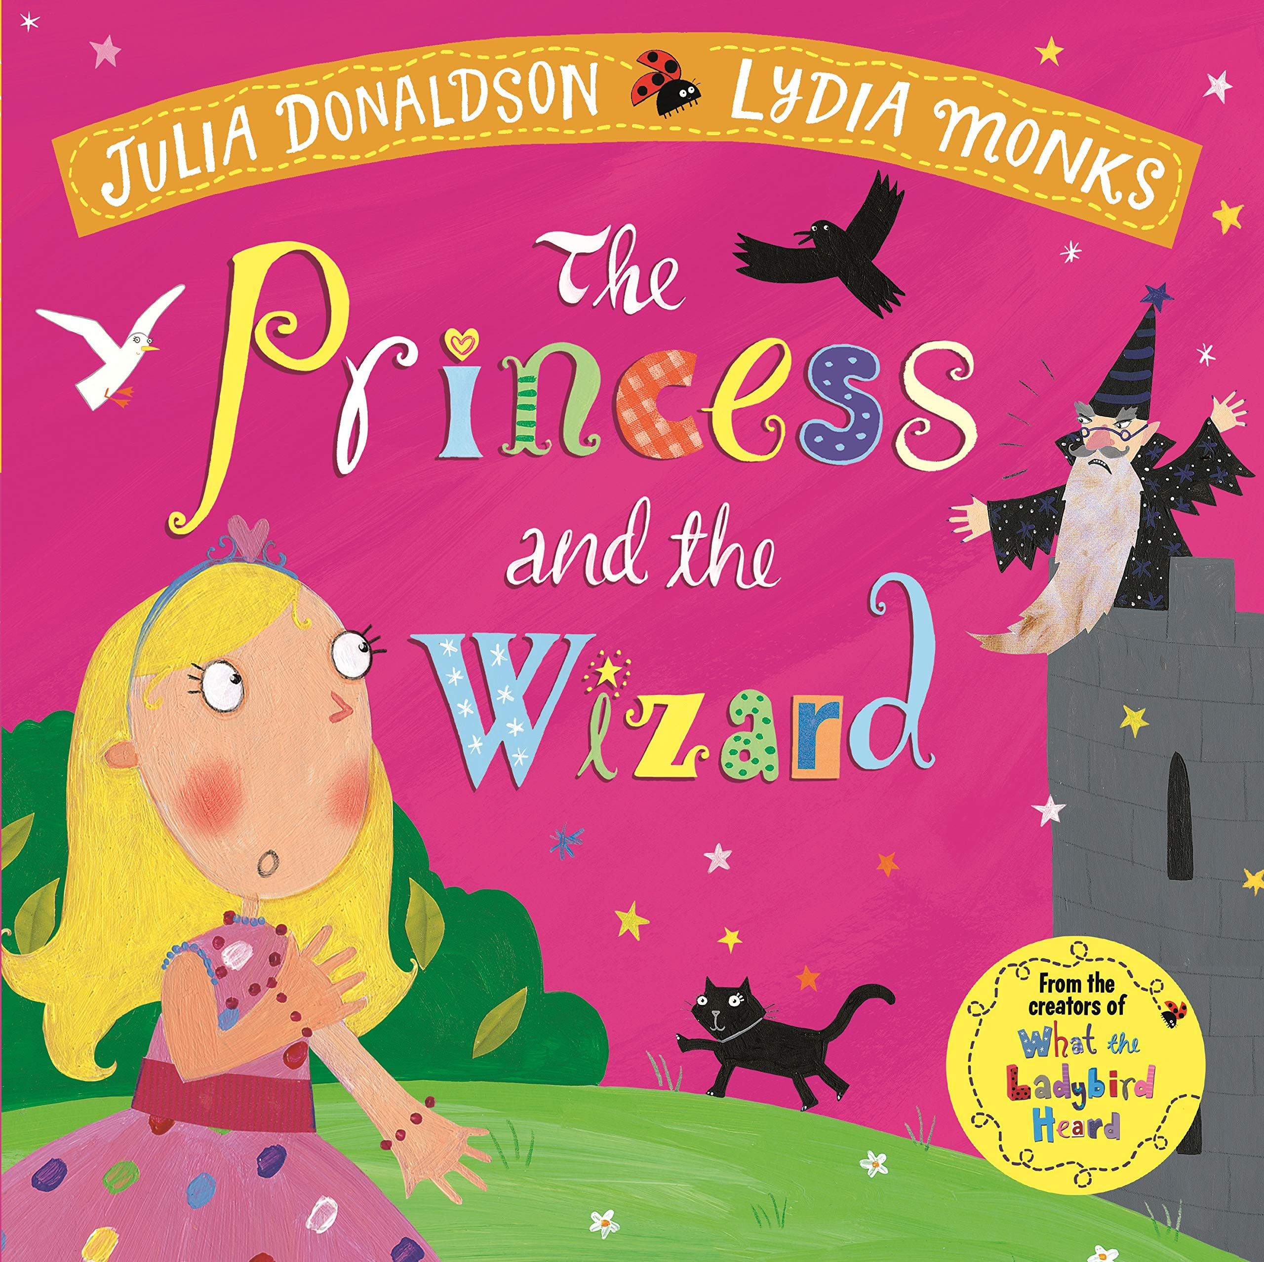


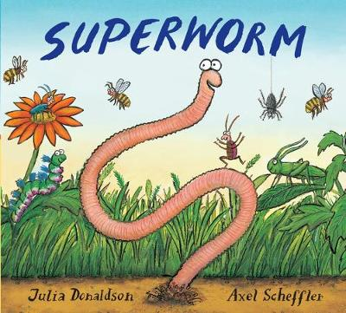
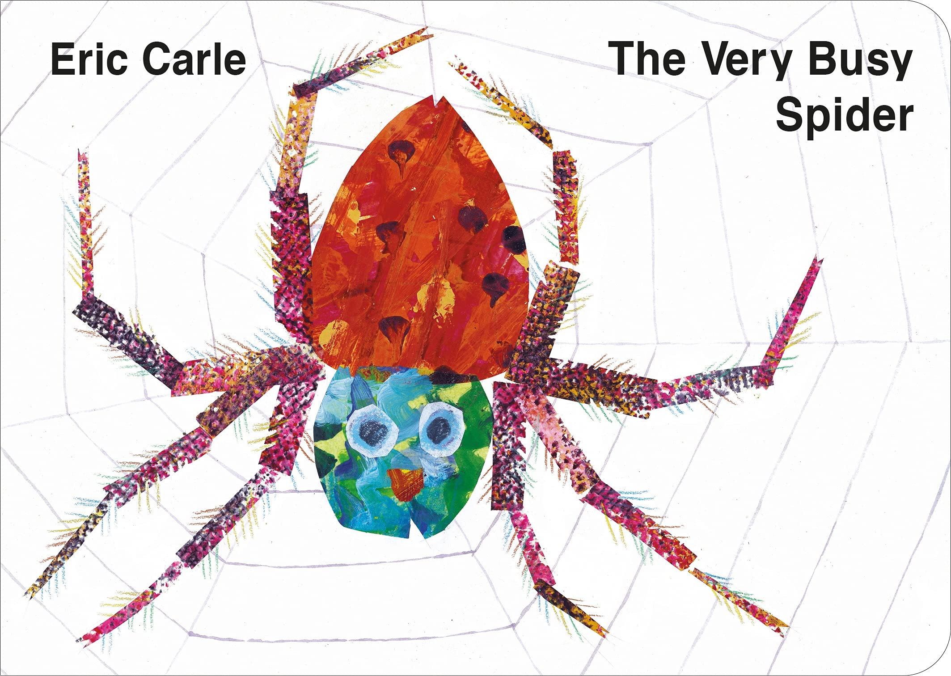
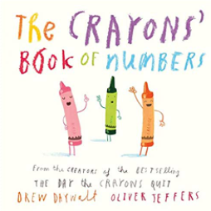


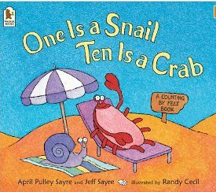

Maths books

Slide 9
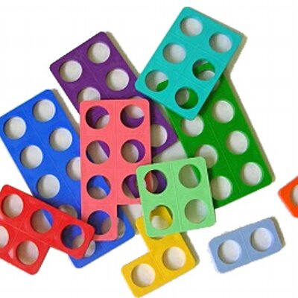

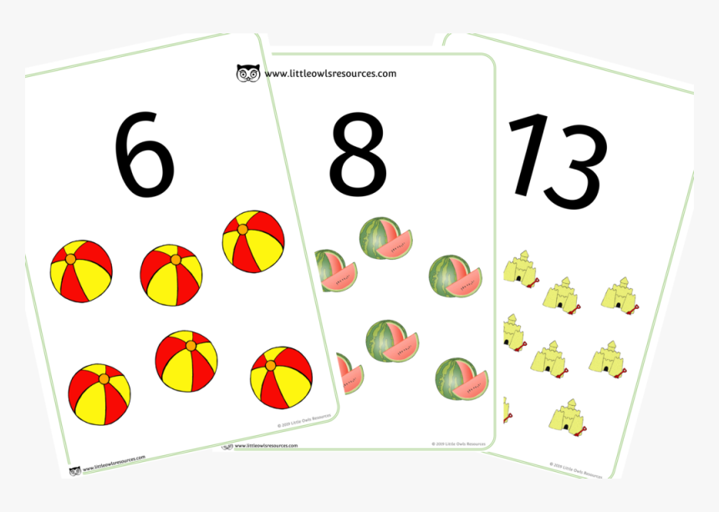
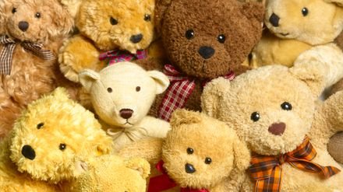
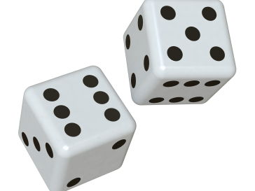
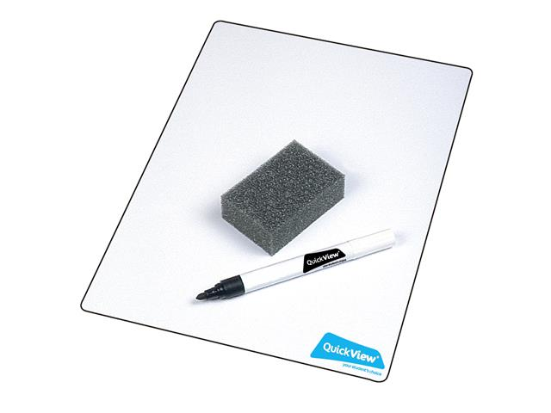
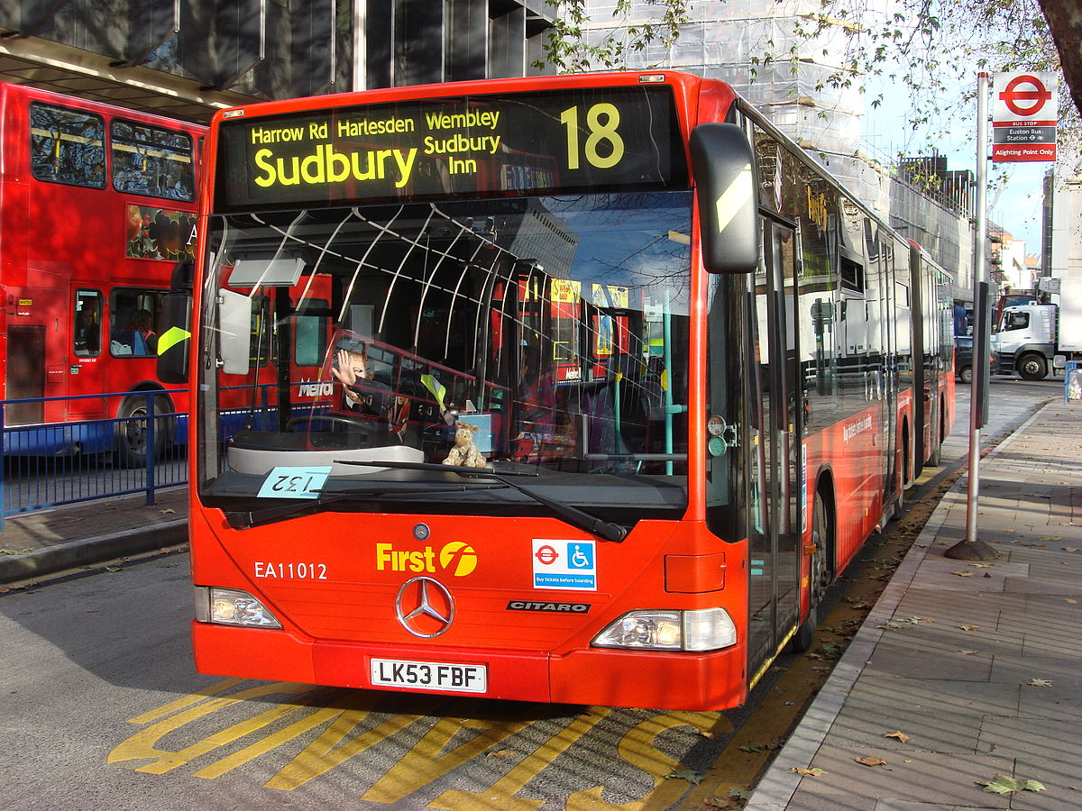
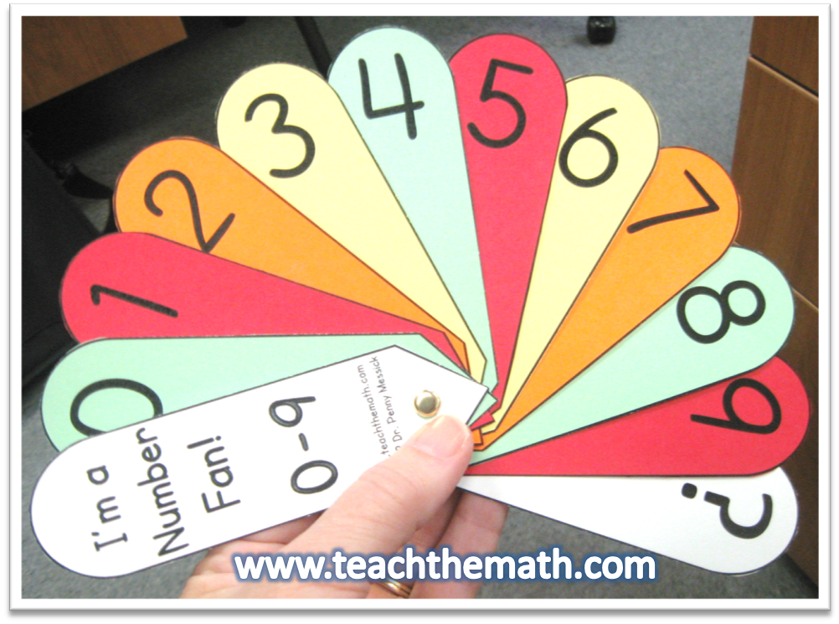
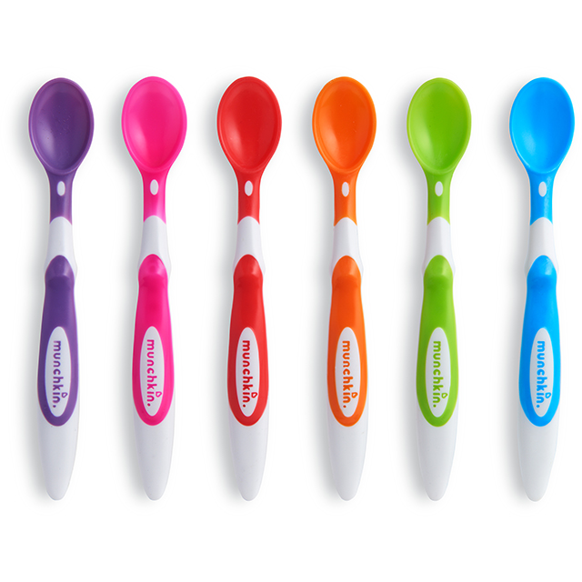

Physical resources

